Slide 1
Java Swing API
Simple GUI application

Slide 2
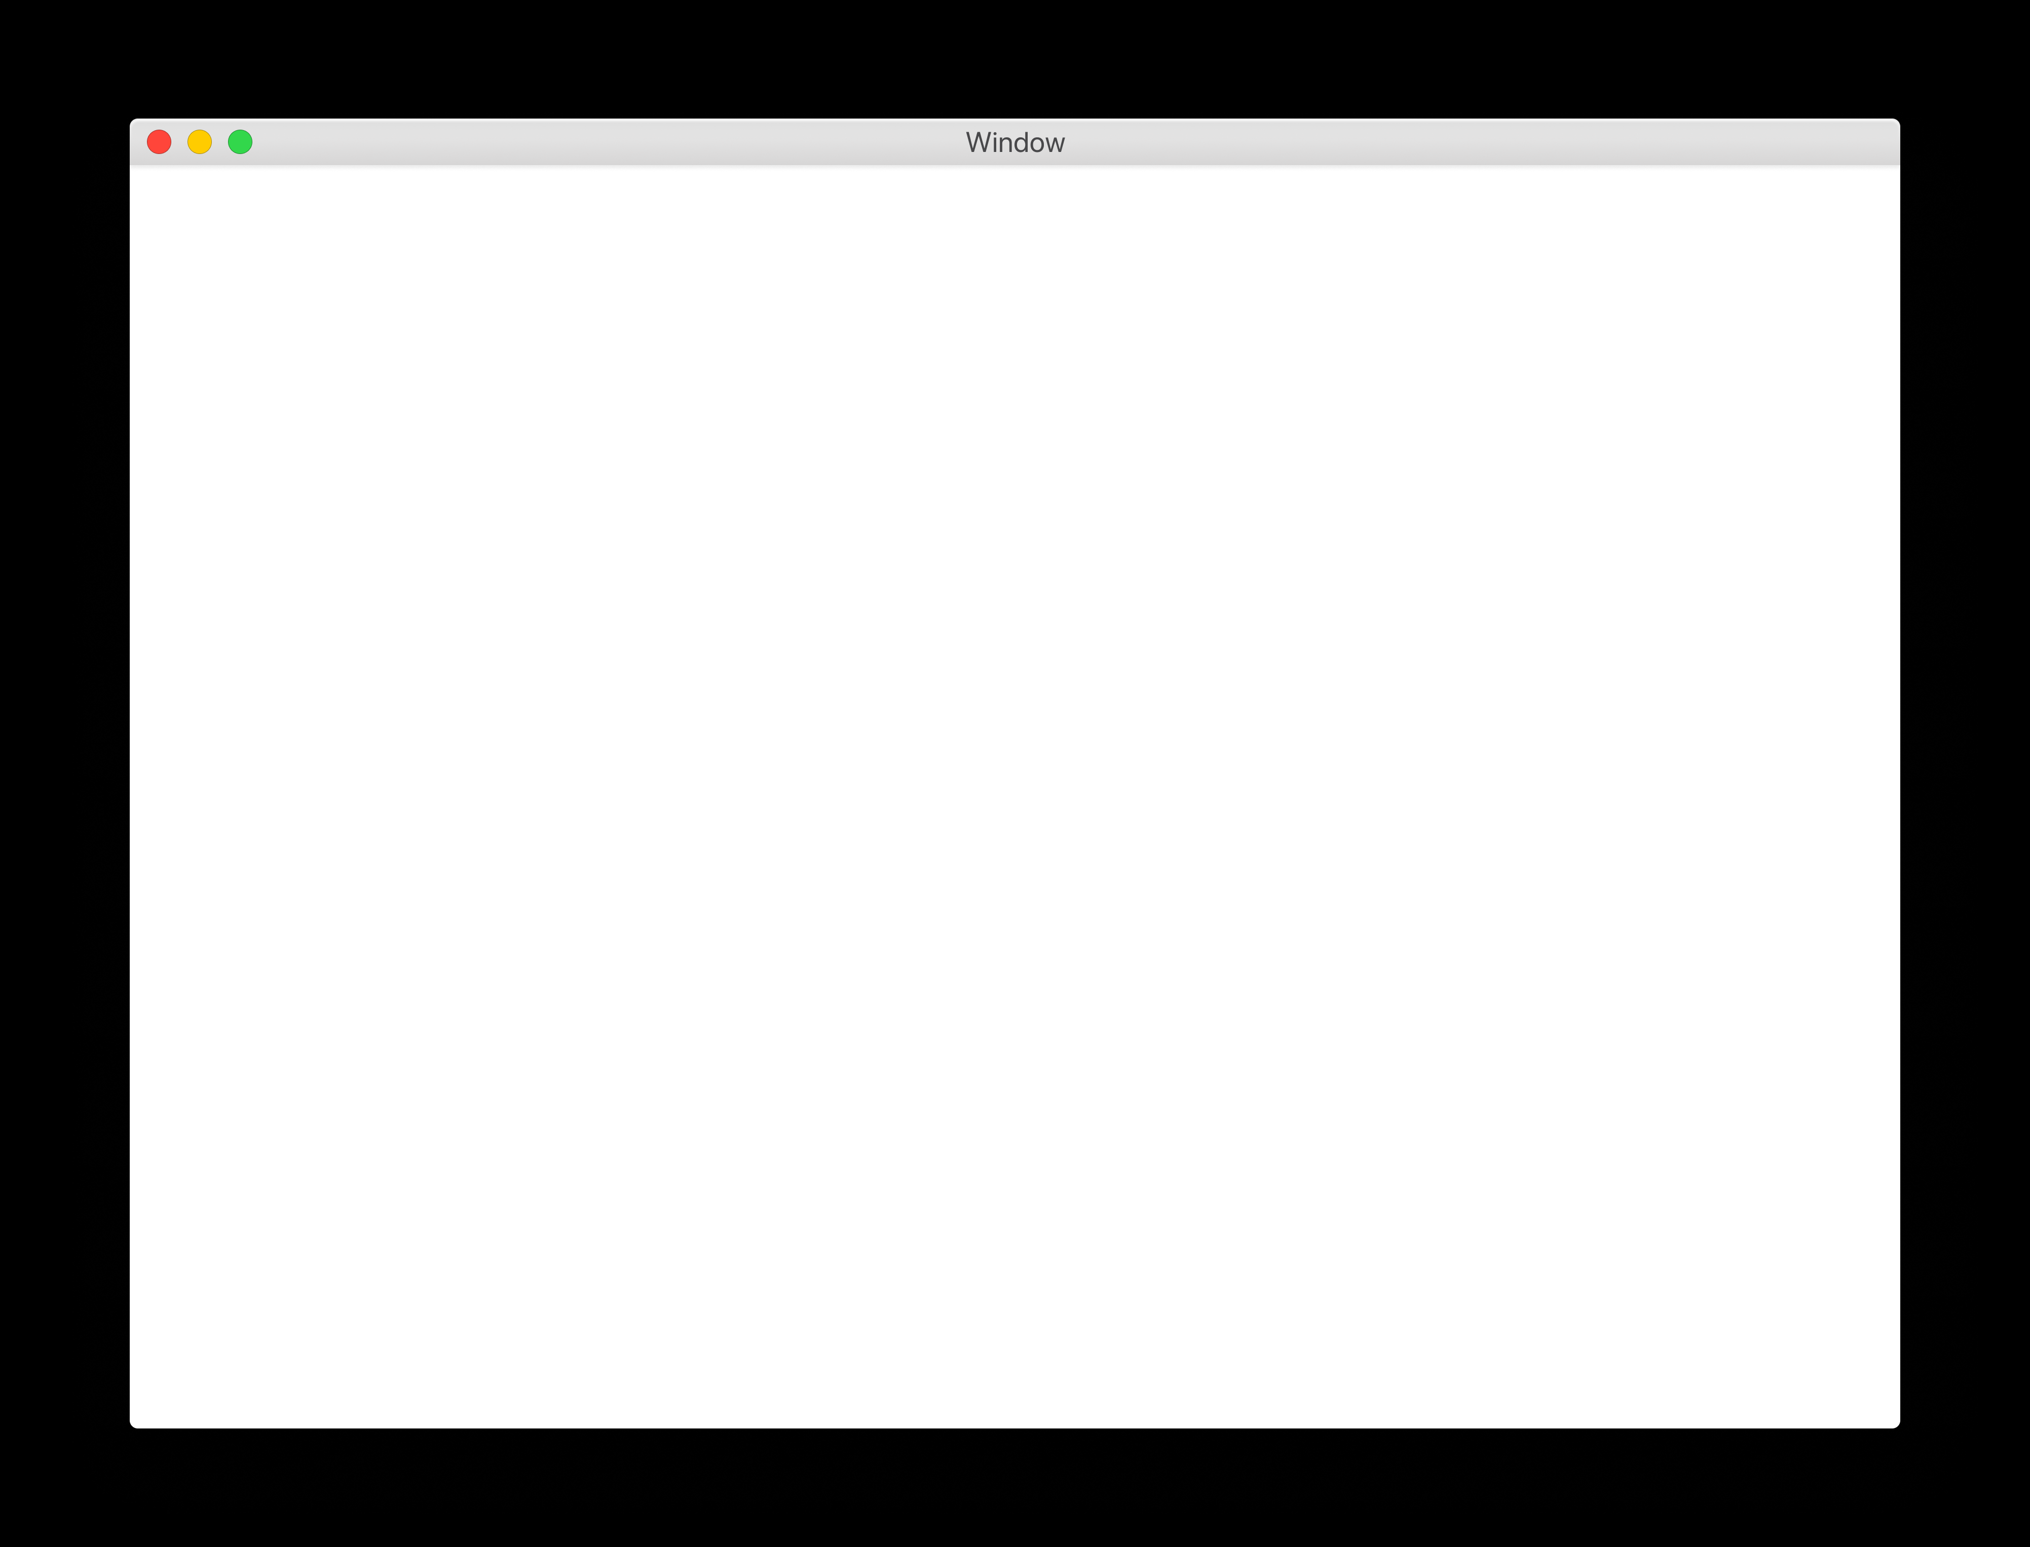
JFrames
A JFrame is a GUI window where you can place components.

Slide 3

Components
Hello World
Button

Slide 4
Sticky Notes

Slide 5

Sticky Notes

Slide 6


